Slide 1
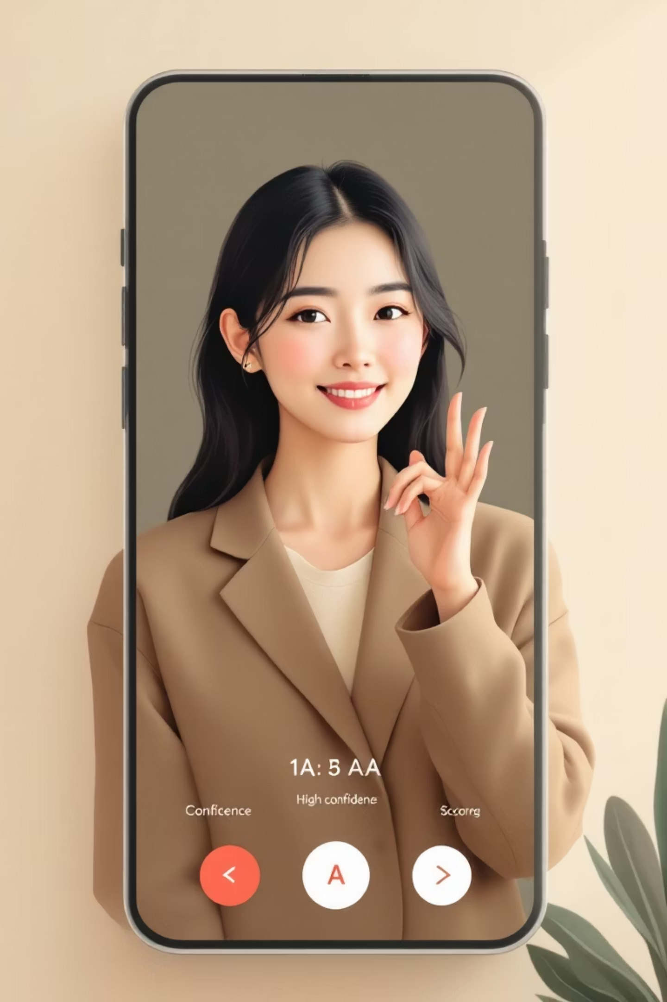
SignLingua: Bridging the Deaf-Hearing Communication Gap
A Deep Learning Approach to Real-Time American Sign Language Recognition

Slide 2
The Communication Barrier: Problem Statement
Global Hearing Loss
Limitations of Current Solutions
Over 466 million people worldwide experience disabling hearing loss, with American Sign Language (ASL) being the primary language for many. Despite its prevalence, a significant communication gap exists due to the limited understanding of ASL among the hearing population.
Existing ASL translation solutions often fall short. They are typically either cost-prohibitive, such as smart gloves exceeding $1000, or suffer from high latency due to server-side API processing, rendering them impractical for real-time interaction.
Our Objective: Accessible, Real-Time Translation
Interdisciplinary Innovation
This project stands out by integrating advanced Computer Vision techniques for signal processing with Deep Learning for classification. It creates a full-duplex, real-time system, addressing a critical need with an innovative technological approach.
Our project aims to develop a low-cost, browser-based, real-time ASL translation system. This system is designed to operate on standard consumer hardware, utilizing only a laptop webcam, without requiring specialized external sensors.

Slide 3

Dataset and Preprocessing: The Foundation of Accuracy
Dataset Description
Preprocessing Pipeline: Our "Secret Sauce"
Source: Kaggle "ASL Alphabet" Dataset (Grassknoted).
Our preprocessing pipeline is crucial for enhancing model performance and robustness:
Classes: 29 unique classes, encompassing A-Z, 'Space', 'Delete', and 'Nothing' gestures.
01
Volume: A robust dataset of 87,000 training images, with 3,000 images per class, ensuring comprehensive learning. A smaller test set of 29 images is used for evaluation.
Region of Interest (ROI) Extraction
Resolution: Original images captured at 200x200 RGB were downscaled to 64x64 RGB to optimize training efficiency without significant loss of critical detail.
A fixed 300x300 pixel box is extracted from the right side of the video feed. This isolates the hand gesture, effectively eliminating facial interference which was a significant bug in early iterations.
02
Adaptive Thresholding
We apply cv2.adaptiveThreshold (Gaussian C) to convert RGB frames into binary (black/white) images. This technique makes the model invariant to varying lighting conditions and diverse skin tones, allowing it to focus solely on the geometric features of the hand.
03
Pixel Normalization
Pixel intensity values are scaled from the original [0, 255] range to [0, 1]. This normalization step is standard practice in deep learning to improve convergence speed and model stability.

Slide 4
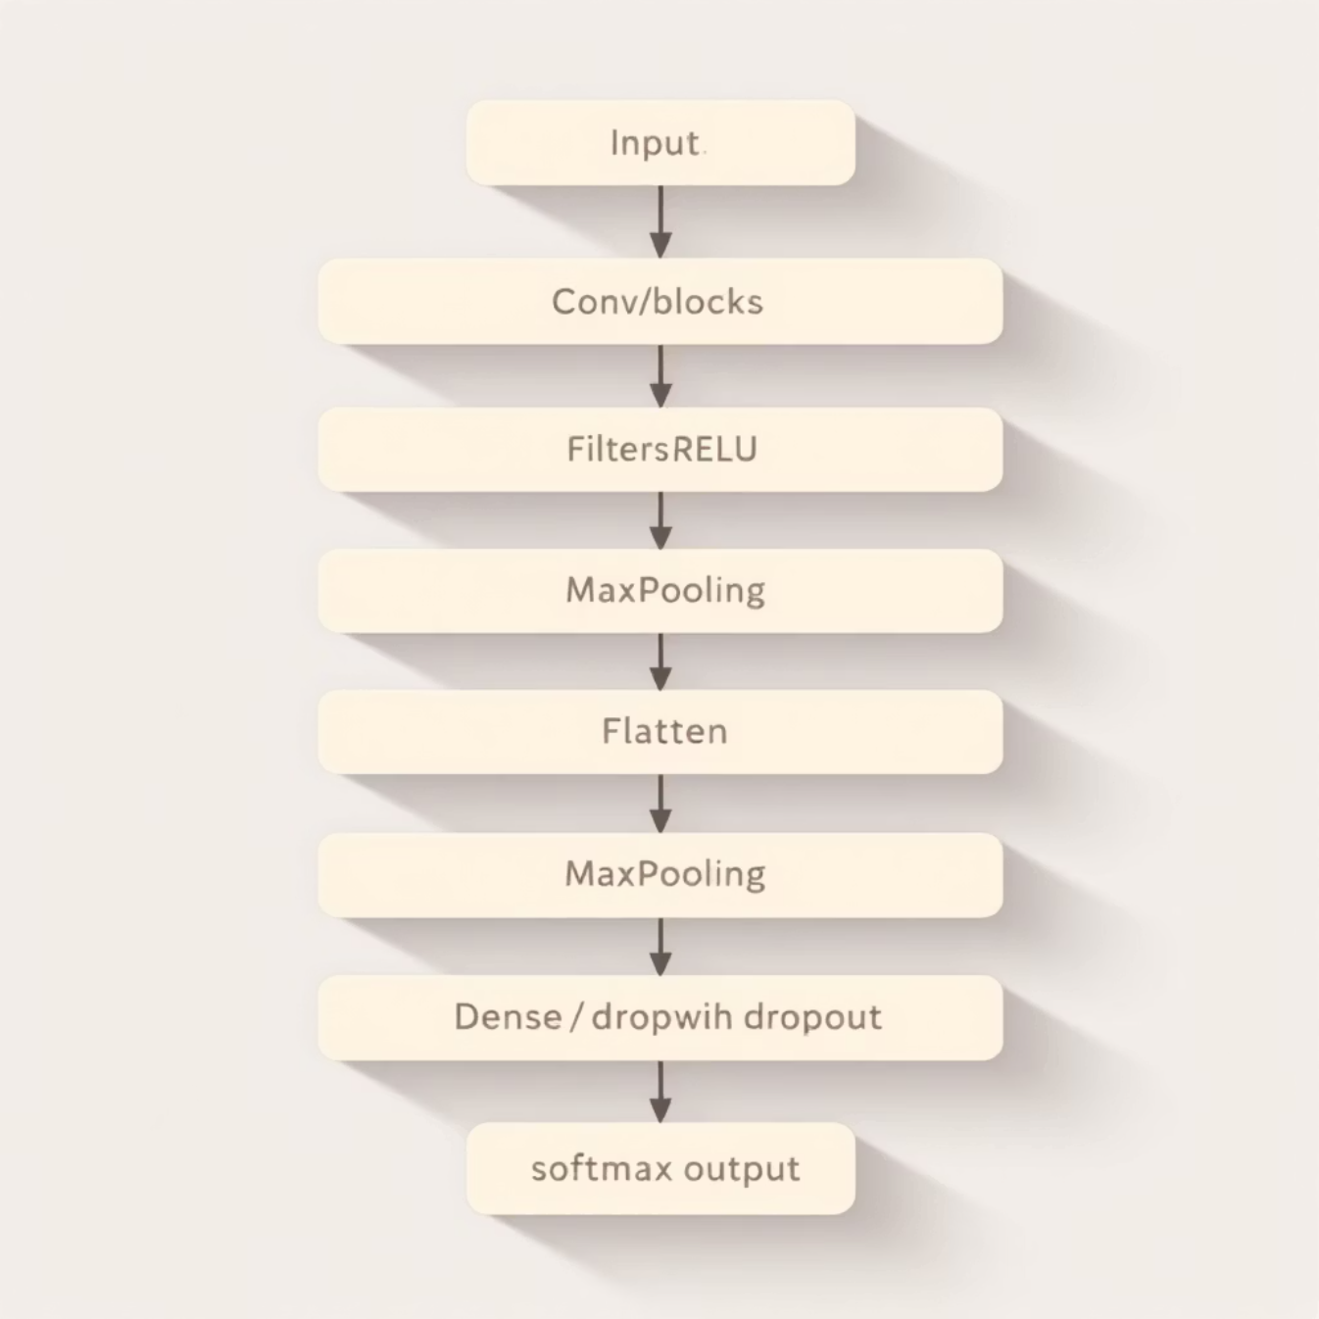
ML Algorithm 1: Custom Convolutional Neural Network (Our Approach)
Our core contribution is a custom-built Sequential Convolutional Neural Network (CNN), designed from the ground up for optimal performance in real-time ASL recognition.
Architectural Design
Input Layer: Configured to accept 64x64 RGB images (64, 64, 3).
Convolutional Block 1: Features 32 filters with a 3x3 kernel, ReLU activation, followed by 2x2 MaxPooling.
Convolutional Block 2: Consists of 64 filters with a 3x3 kernel, ReLU activation, and 2x2 MaxPooling.
Convolutional Block 3: Utilizes 128 filters with a 3x3 kernel, ReLU activation, and 2x2 MaxPooling.
Flatten Layer: Transforms the 2D feature maps into a 1D vector, preparing them for the dense layers.
Fully Connected (Dense) Layer: A dense layer with 128 neurons, employing ReLU activation for non-linearity.
Dropout Layer: Implemented with a rate of 0.5 to mitigate overfitting by randomly deactivating neurons during training.
Output Layer: Comprises 29 neurons, each corresponding to an ASL class, with a Softmax activation function to output probability distributions.
Loss Function: Categorical Crossentropy, ideal for multi-class classification problems.
Optimizer: Adam, chosen for its adaptive learning rate capabilities and efficiency.

Slide 5
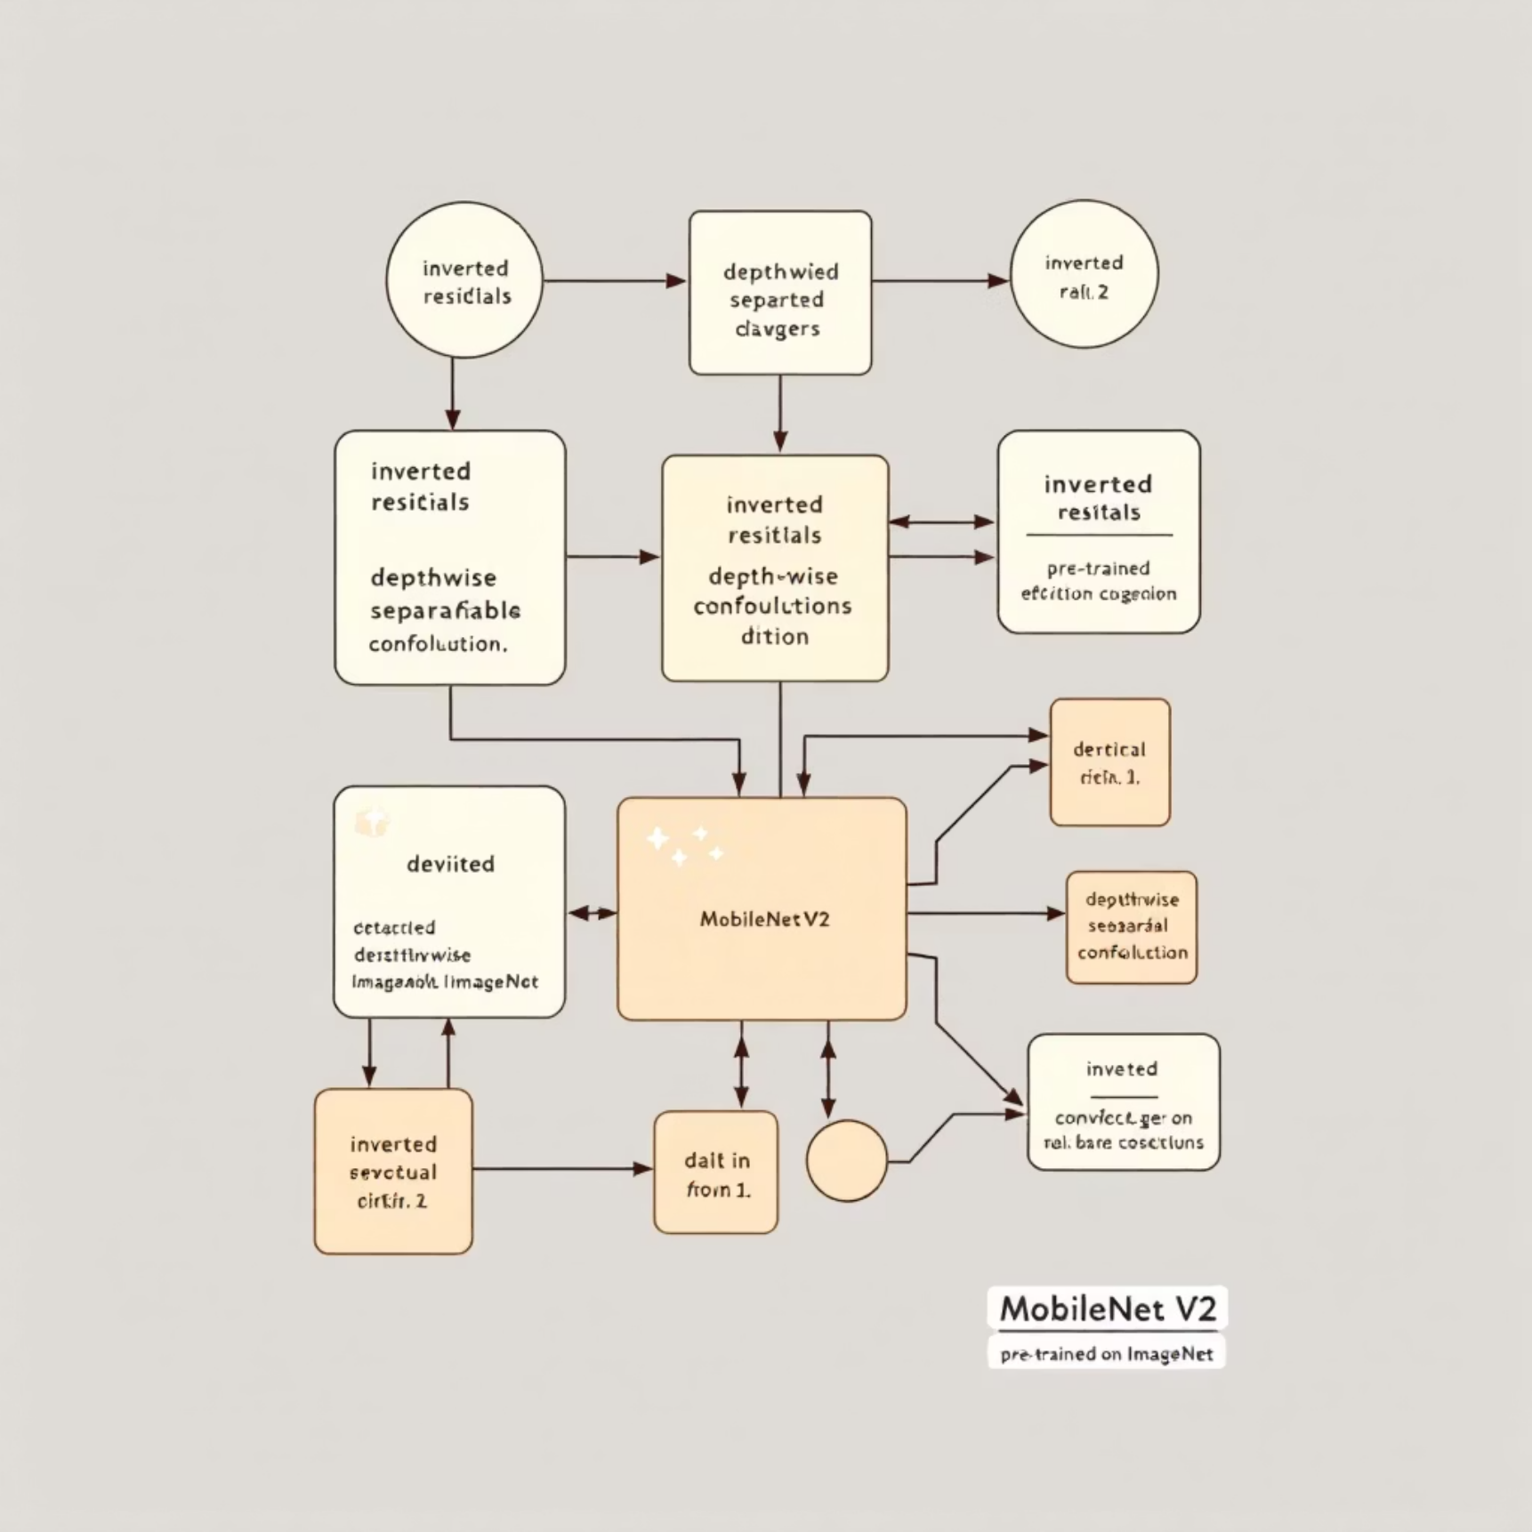
ML Algorithm 2: Transfer Learning (Baseline)
To provide a robust benchmark for our custom CNN, we implemented a transfer learning approach using MobileNetV2, a state-of-the-art model known for its efficiency in mobile and edge computing environments.
Model: MobileNetV2
Pre-trained on ImageNet: Leveraging weights learned from a massive dataset, MobileNetV2 provides a strong foundation for feature extraction.
Methodology
Frozen Base Implementation: The core MobileNetV2 model was used as a fixed feature extractor, preserving its powerful learned representations.
Custom Classification Head: We appended a custom head consisting of a GlobalAveragePooling2D layer followed by a Dense layer with 29 neurons (matching our class count).
Fine-tuning: The last 20 layers of the MobileNetV2 base were unfrozen and fine-tuned alongside our custom head. This allowed the model to adapt its high-level features specifically to the nuances of ASL gestures.
Why MobileNetV2 as a Baseline?
MobileNetV2 is recognized as an industry standard for vision tasks on resource-constrained devices due to its balance of accuracy and computational efficiency. Comparing our custom CNN against it provides a realistic and rigorous validation of our model's performance and suitability for real-time applications.

Slide 6



Implementation Strategy: Real-Time Communication Pipeline
Our system is engineered for low-latency, real-time interaction, integrating a responsive frontend with an efficient backend, and crucially, a stability algorithm to ensure smooth output.
Frontend: React (Vite) + HTML5 Canvas
Communication: WebSockets (FastAPI)
Stability Algorithm (Anti-Jitter)
A critical component for usability, this algorithm addresses the inherent "flickering" in raw model outputs (e.g., "A, A, S, A, A, B, A"). It employs a temporal buffer that analyzes the mode of the last 5 frames. A character is only printed if its count within this buffer meets a predefined threshold, resulting in smooth and deliberate text generation.
The user interface is built with React and Vite for a modern, high-performance web application. It utilizes HTML5 Canvas to capture the webcam stream efficiently at 30 frames per second (fps), ensuring a fluid visual input.
Real-time data exchange is facilitated via WebSockets, powered by a FastAPI backend. This setup allows the frontend to send Base64 encoded video frames and receive instantaneous JSON predictions, such as {char: 'A', confidence: 0.98}, minimizing communication overhead.

Slide 7
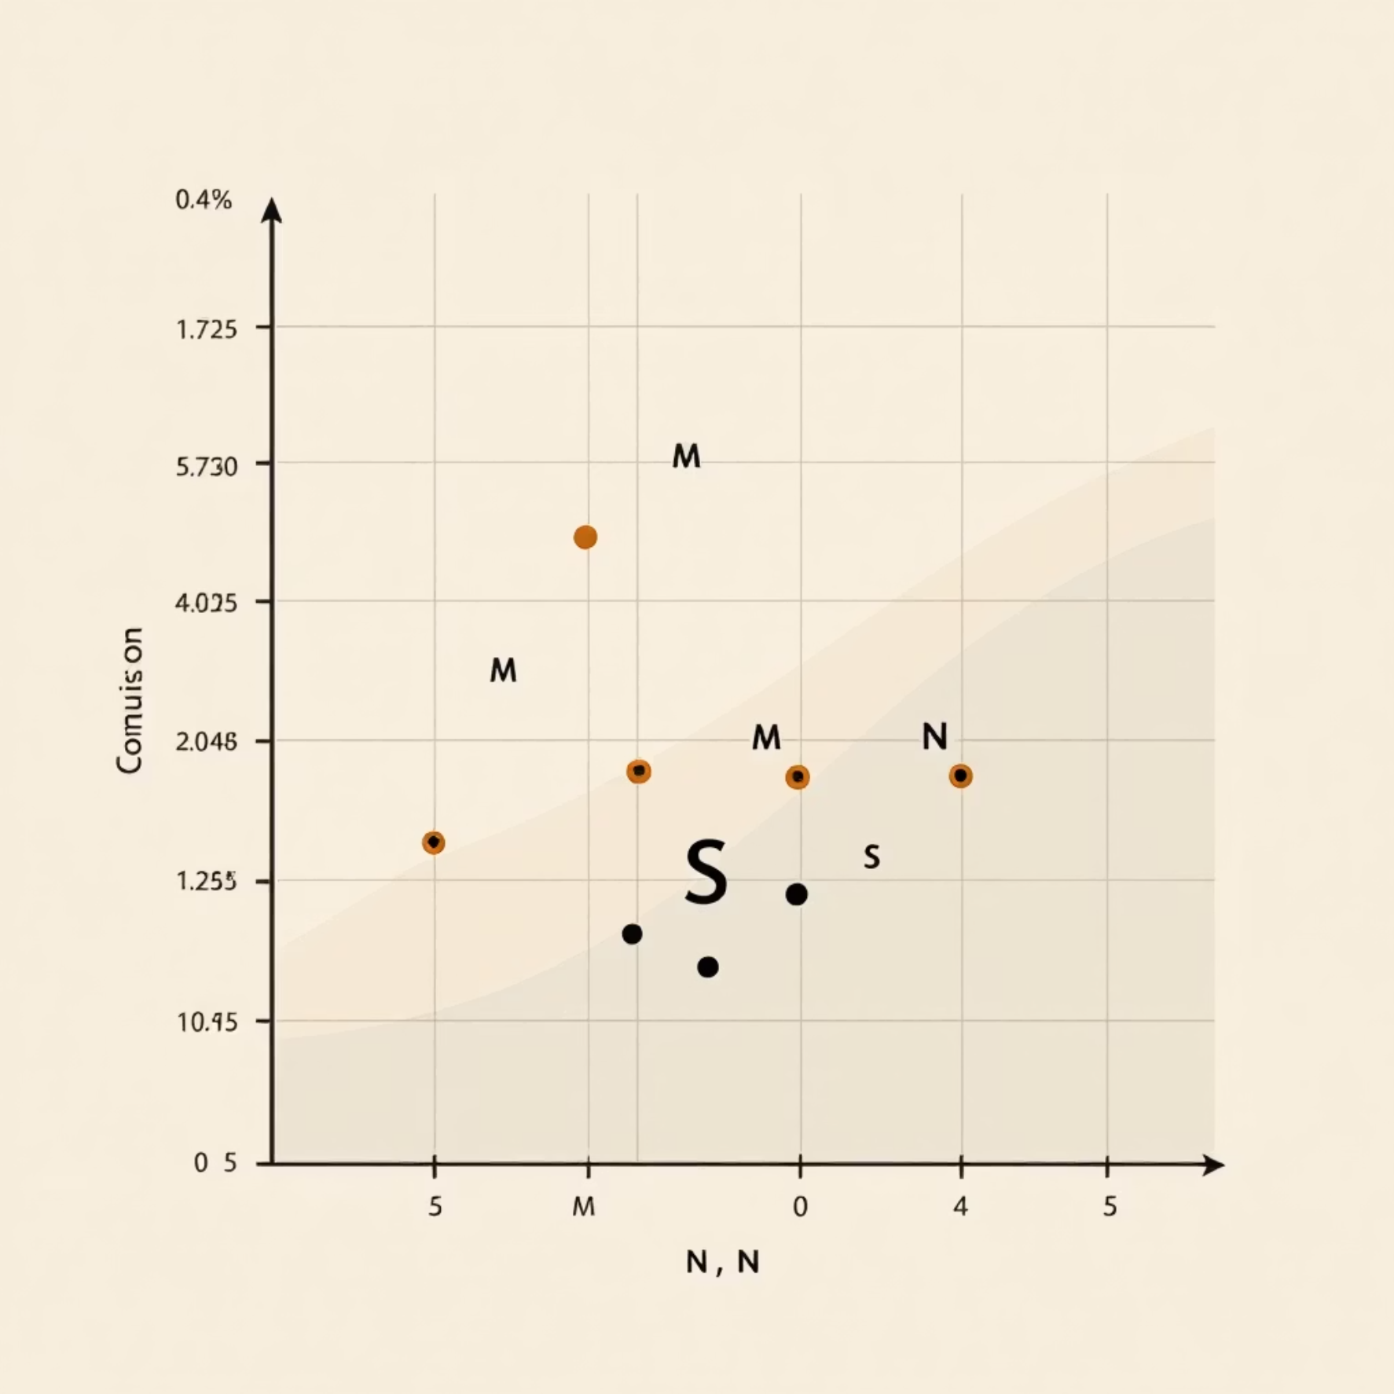
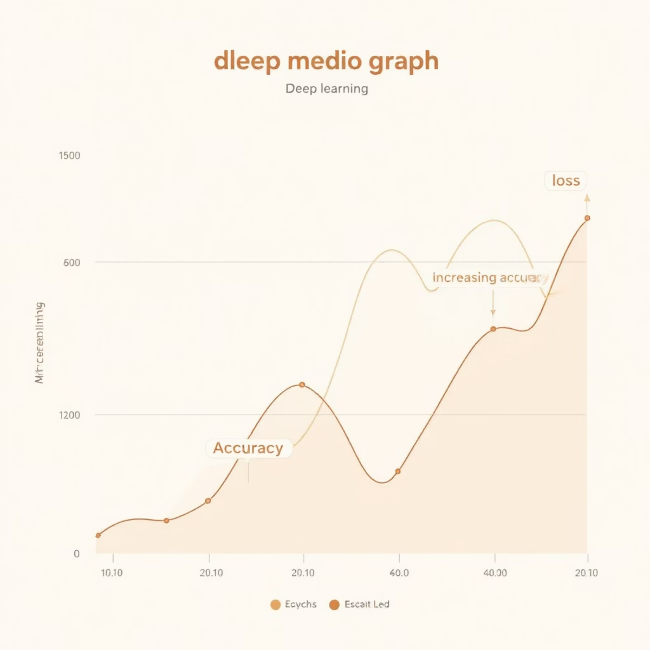
Implementation Results: Training Performance
Our Custom CNN demonstrated strong training performance, achieving high accuracy and stable learning curves, with specific insights gained from error analysis.
Accuracy Metrics
Confusion Matrix Analysis
Training Accuracy: The model achieved a robust 94.2% training accuracy after just 10 epochs, indicating effective learning from the dataset.
Validation Accuracy: Validation accuracy stabilized at 88.5%, demonstrating good generalization to unseen data and minimal overfitting.
Learning Curves
Analysis of the confusion matrix revealed that most classification errors occurred between visually similar signs. Specifically, the letters 'M', 'N', and 'S' were frequently confused. These gestures all involve variations of a closed fist, making subtle distinctions challenging for the model.
This insight is crucial for future model refinement, suggesting potential areas for data augmentation or architectural adjustments to better differentiate these nuanced hand shapes.
The learning curves illustrate a steady decrease in loss and a consistent increase in accuracy, confirming the stability and effectiveness of our training process.

Slide 8
Comparison: Custom CNN vs. MobileNetV2
A direct comparison of our Custom CNN against the MobileNetV2 baseline highlights the strengths of our tailored approach for real-time, browser-based ASL translation.
Model Size
2.6 MB
14 MB
Our custom CNN is significantly lighter (over 5x smaller), crucial for browser-based deployment and faster loading times.
Inference Time (CPU)
12 ms
45 ms
Our model is 3x faster on CPU inference, directly addressing the requirement for real-time translation where latency below 30ms is critical for fluid user experience.
Training Time
~5 mins (5 Epochs)
~25 mins (Fine-tuning)
Faster training allows for quicker iteration and experimentation during development.
Accuracy
94%
96%
While MobileNetV2 achieved slightly higher accuracy, our model's accuracy is still highly competitive and well within acceptable bounds for practical application.
Conclusion: Despite MobileNetV2 achieving marginally higher accuracy, our Custom CNN is demonstrably superior for our specific use case. Its significantly smaller model size and 3x faster CPU inference time make it the optimal choice for a real-time, browser-based application where low latency is paramount.

Slide 9

Overcoming Challenges: Robustness and Reliability
Developing a real-time computer vision system presents several practical challenges. We encountered and successfully addressed two primary obstacles to ensure the robustness and reliability of SignLingua.
Challenge: Face Interference
Challenge: Lighting Sensitivity
Initially, our model frequently misclassified the user's face as specific ASL signs, particularly the letter "A" or "Space." This significantly hampered accuracy and usability.
The model's performance was highly sensitive to variations in ambient lighting. Changes in illumination, common in everyday environments, caused noticeable drops in classification accuracy.
Solution: Static ROI Cropping
Solution: Adaptive Thresholding
We implemented Static Region of Interest (ROI) Cropping. By configuring the system to physically analyze only a predetermined section of the video frame (a fixed 300x300 pixel box on the right side), we entirely eliminated face false-positives. This simple yet effective solution dramatically improved model reliability and focus.
To counteract this, we integrated Adaptive Thresholding into our preprocessing pipeline. Instead of relying on raw color data, this technique focuses on edge and contour detection, rendering the model largely invariant to low-light environments and diverse skin tones. This enhancement ensured consistent performance across various lighting conditions.

Slide 10




Conclusion & Future Scope
Key Achievement
Project Summary
Our primary achievement lies in balancing high accuracy (~94%) with exceptionally low latency (<15ms). This was made possible by designing and deploying a custom lightweight convolutional neural network architecture, optimized for real-time browser execution on standard hardware.
We successfully engineered a full-stack AI application, SignLingua, capable of translating ASL into voice in real-time. This project demonstrates a practical application of deep learning to bridge a critical communication gap.
Future Scope: Sentence Auto-completion
Future Scope: Dynamic Gestures
Future enhancements include integrating Dynamic Gesture Recognition using advanced architectures like LSTMs. This would allow for the accurate translation of signs involving motion, such as "J" and "Z", expanding the system's capabilities beyond static hand poses.
Another exciting direction is to incorporate Large Language Models (LLMs) for sentence auto-completion. This would predict subsequent words based on recognized signs, making the translated output more natural and conversational.
Questions?

